Slide 1
ESE Engineering Project V Project 3: Etch Auto Sketch
Fergus Page
December 4th, 2025

Slide 2

Project Overview:
Posture-recognition software evaluates user.
Posture encoded as controller commands.
Software communicates wirelessly with controller.
Controller articulates Etch A Sketch.
PI-Controlled DC, stepper motors.

Slide 3
Extended Applications
Remote, multi-pilot medical robots.
Exactly-repeated experimental research iterations.
Proxy agent for dangerous work.
A whimsical home message board.
User-scaling APPLICATIONS & COMBINATIONAL CONTROL.

Slide 4
United Nations Sustainable Development Goals
Goal 3: Good Health and Wellbeing.
Goal 4: Quality Education.
Goal 9: Industry, Innovation, and Infrastructure.
Goal 10: Reduced Inequalities.
Goal 17: Partnerships for the Goals.

Slide 5
System Overview
RPi 5 and STM32F303RE
Webcam, NRF24L01+, SSD1306, TL082, TL084
L293D and A4899
FIT0185 and 17HS4401S
Etch A Sketch – Large, Red

Slide 6
Software and Control Considerations
Raspbian Linux video capture/DSP.
RPi 5 and controller communicate bidirectionally.
C-coded finite state machine.
PI-controlled DC motor.
Controller features tunable physical alignment.

Slide 7
RF, Safety, and Compliance Considerations
RF-Compliant Transceiver Module (EU)
IEC 62368-1 Compliant Power Supply (+)
Additional Copper Ground Buss (Supply)
Cable Routing by Signal Speed
Cable Routing by Power

Slide 8
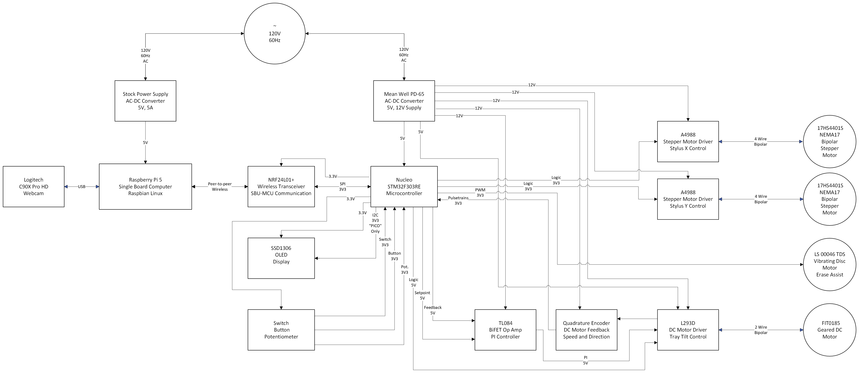
Top Level System Diagram

Slide 9
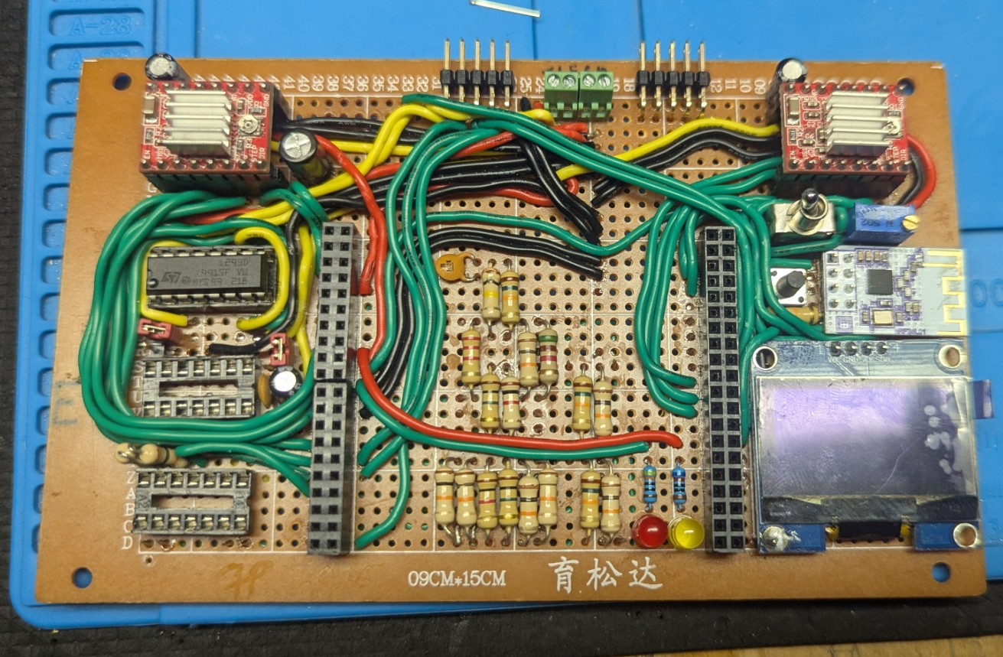
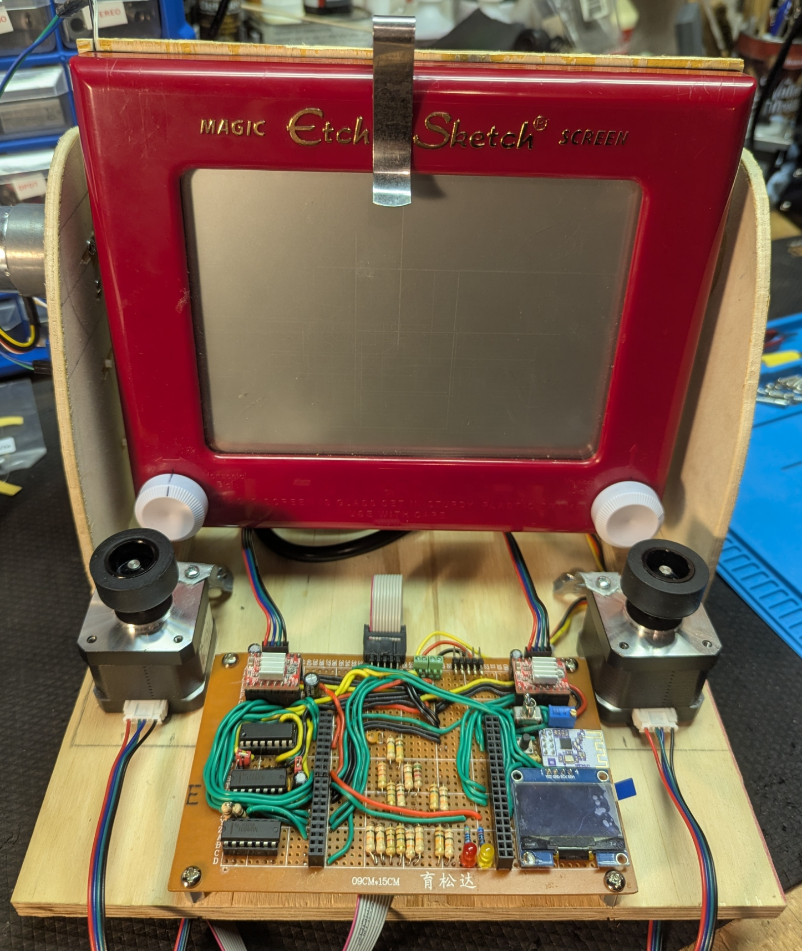
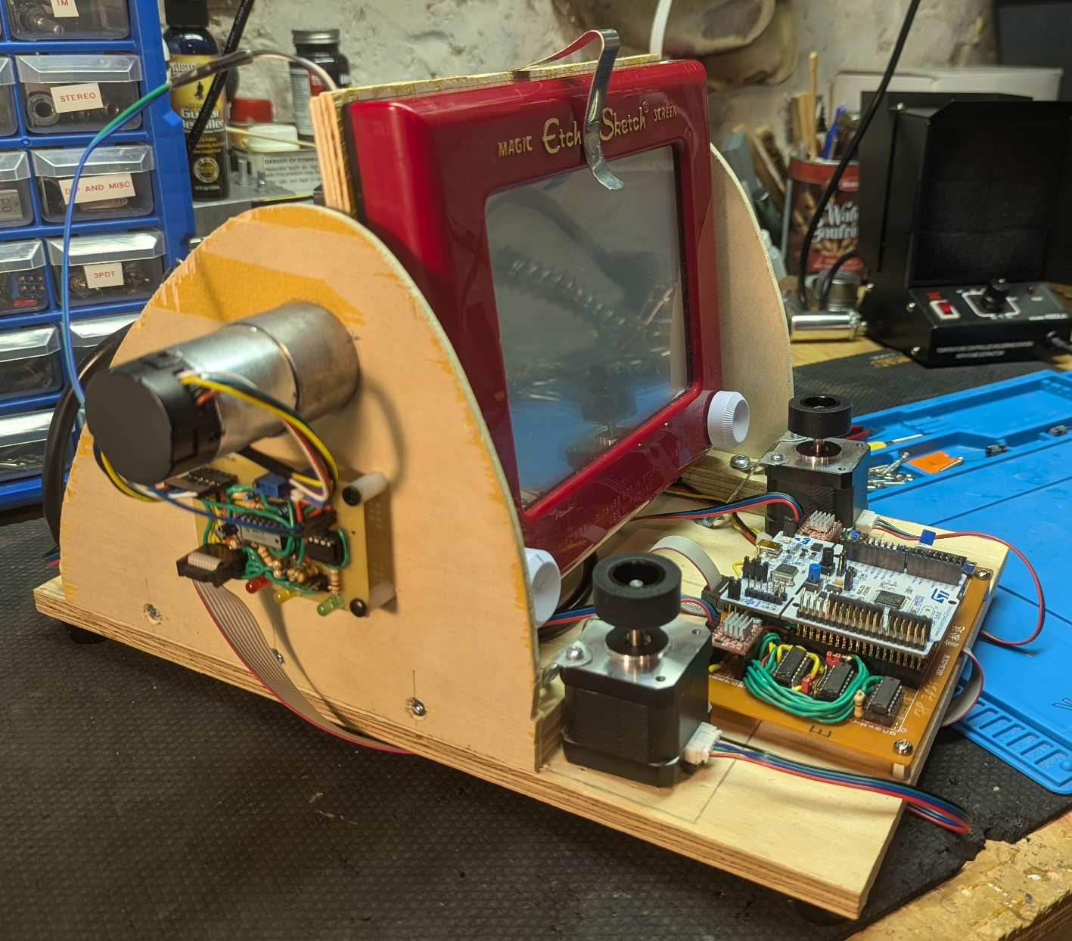
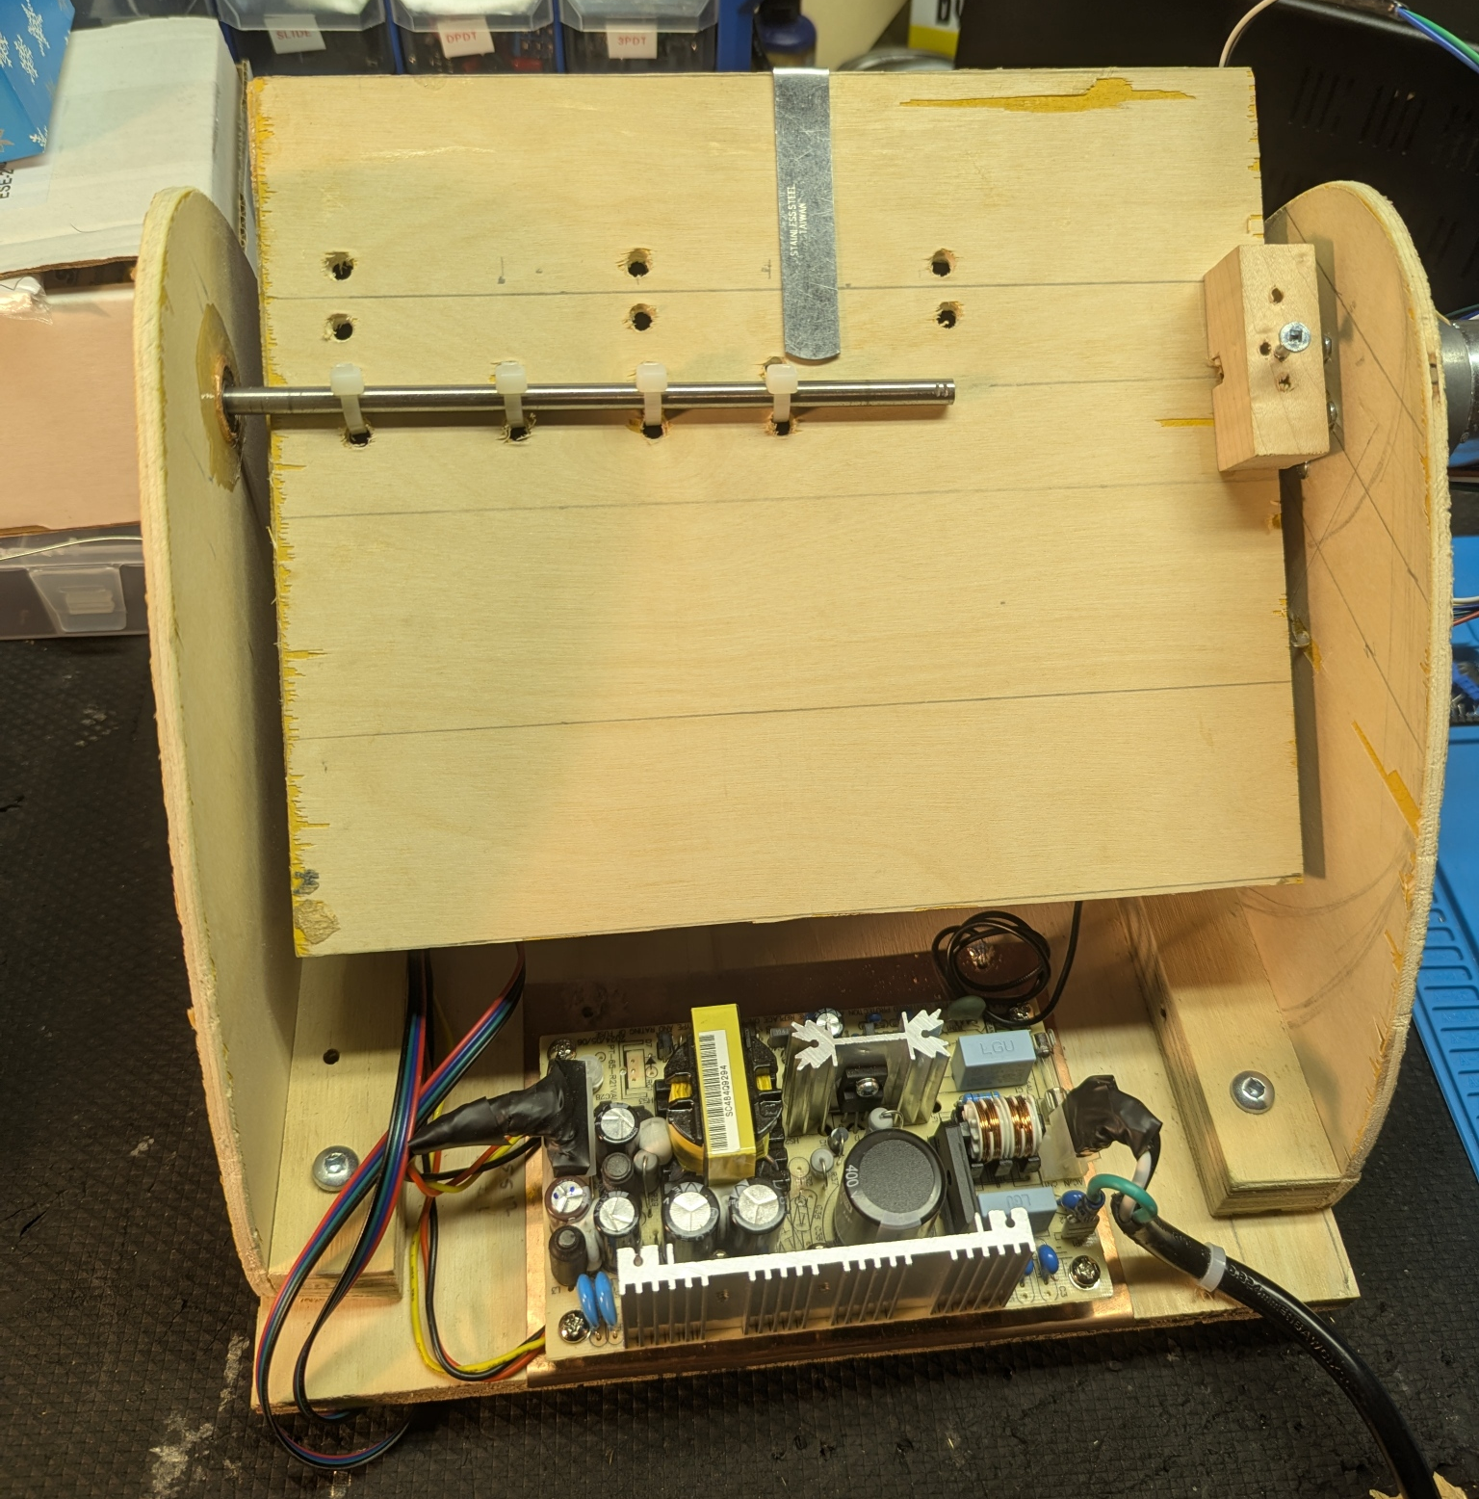
System Prototype

Slide 10
DC Motor Characterization
FIT0185 High-Torque Geared Motor
Moment of Inertia Not Available
Calculated Approximate Value Using Datasheet
Motor Torque Exceeds Meter Limit

Slide 11
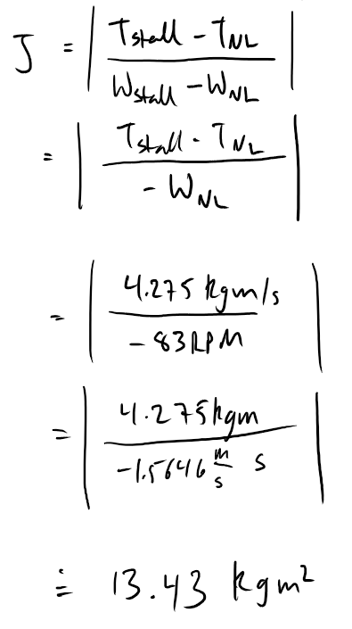
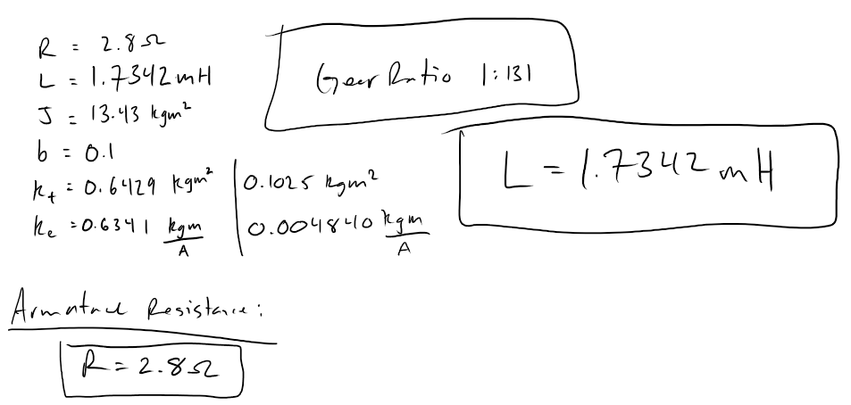
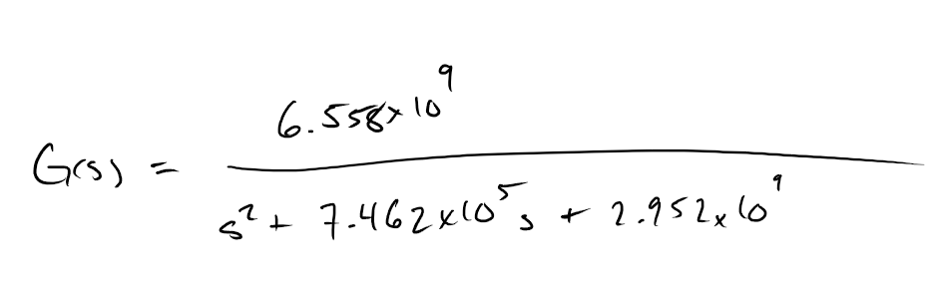

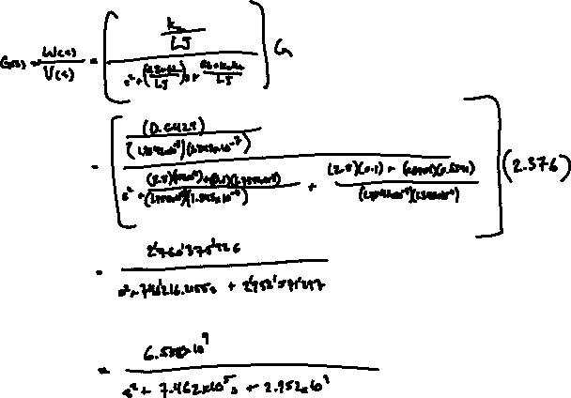
Motor Characterization Calculations

Slide 12
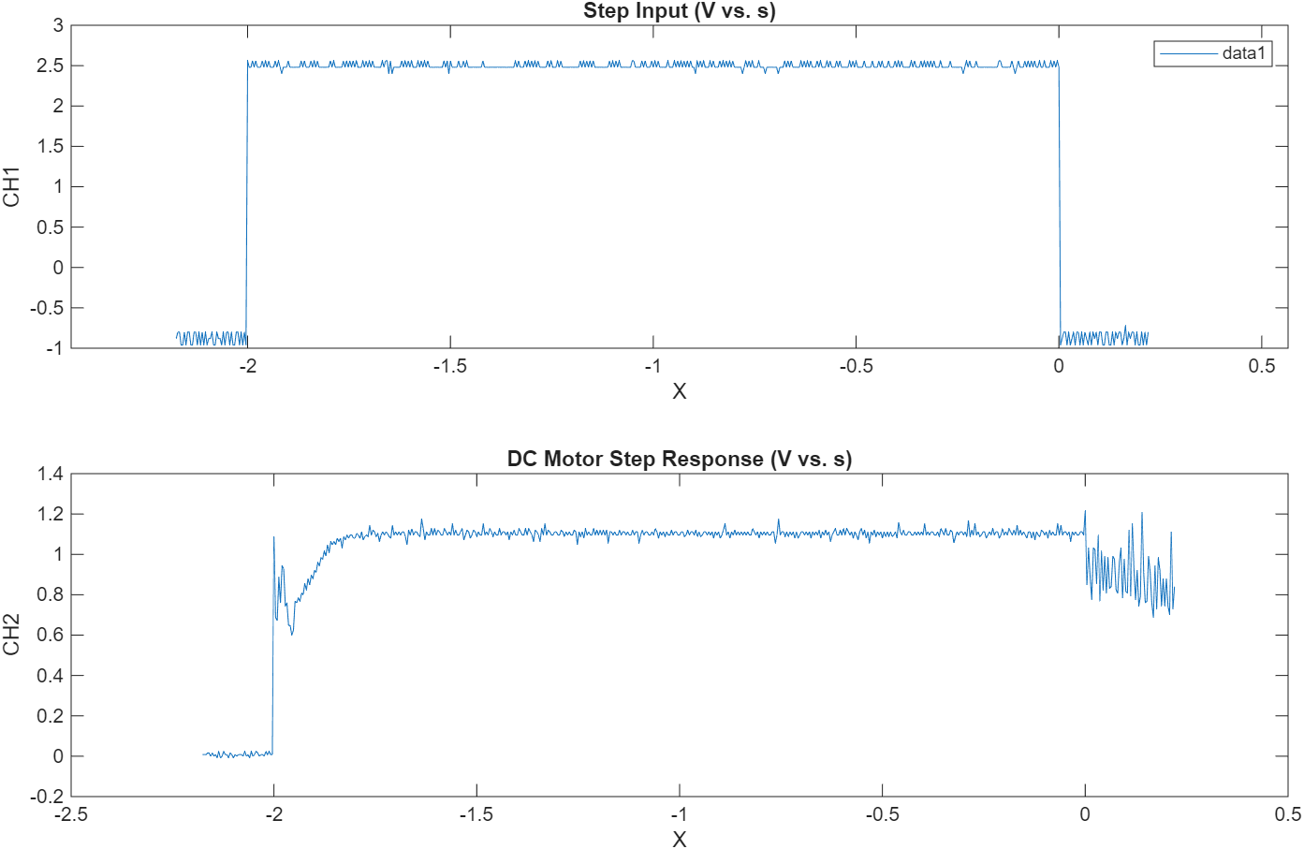
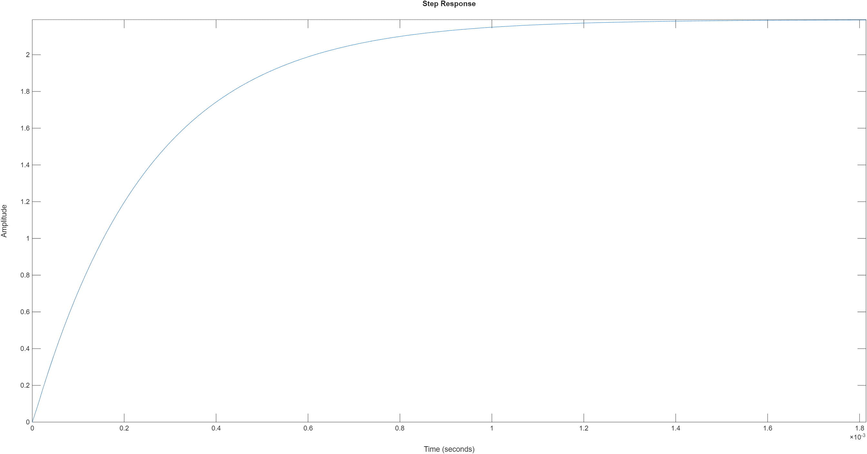
Step Responses

Slide 13
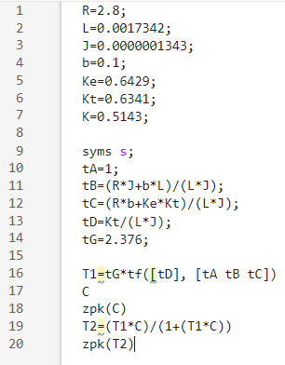
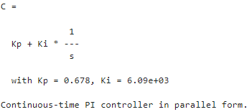
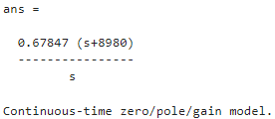
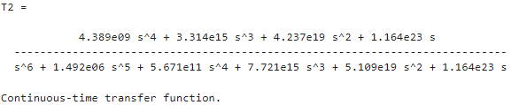
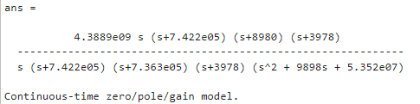
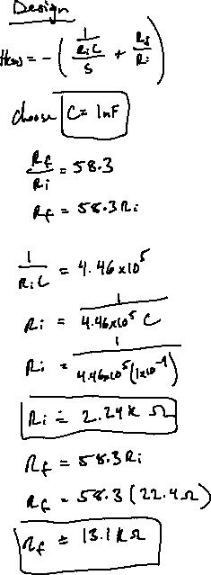
PI Controller Calculations

Slide 14
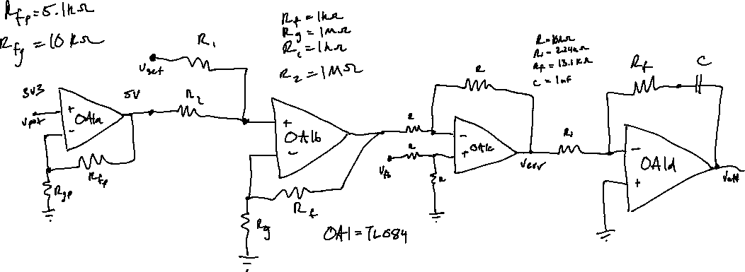
PI Controller

Slide 15
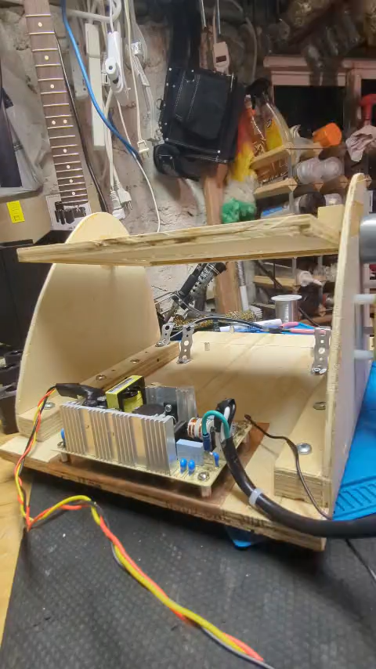
DC Motor - Erase

Slide 16
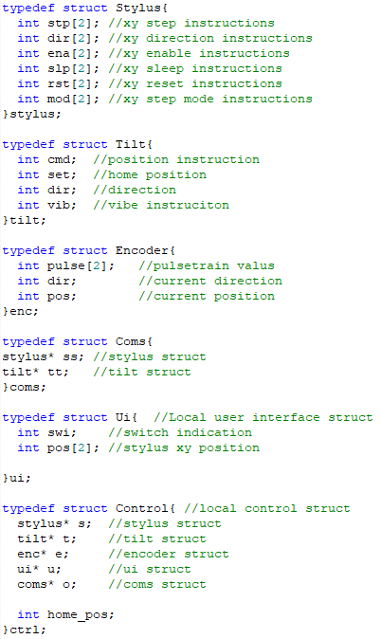
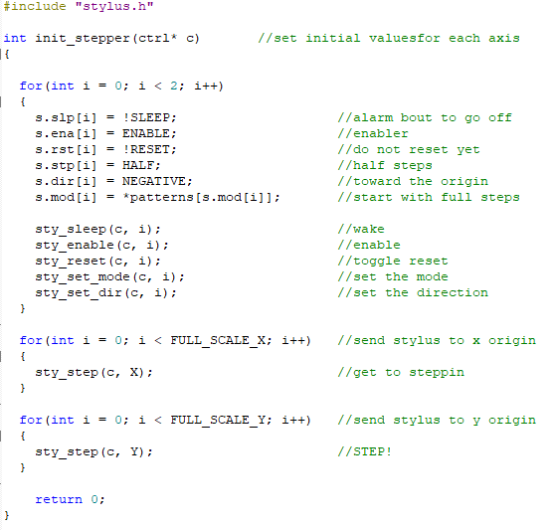
Code Highlights

Slide 17
Techniques, Resources, and Tools
Torque, Torsion, Tolerance, and Alignment
STM32, RPI5, Signal Generator, Oscilloscope
Quadrature Encoder, STM Encoder Mode
MATLAB PI Design, Electronic Implementation
MATLAB Oscilloscope Plotter Script

Slide 18
Materials, Components, Sustainability & Circularity Design
Scrap Plywood: an Engineered Material
Low-Friction Bearing Reduces Load
Soft Rubber Rollers Grip Controls
Enables Aggressive Conservancy Measures, Safely
Remote-Physical Connection Reduces Waste

Slide 19
Health, Social, Environmental Proactive Views
Improves Rural & Remote Medical Access
Protects Humans Doing Dangerous Work
Enhances and Modernizes Scientific Research
Enables New Controls and Applications
Connects People and Humanoids Everywhere

Slide 20
Acknowledgements
Thank you to So-Ra Chung and Alireza Dehghani-Sanij for their help and guidance throughout this term, and with this project.
I am very grateful, and I feel lucky to learn from them.

Slide 21
References
Application Report: Designing Gain and Offset in Thirty Seconds, vol. SLOA097. Dallas: Texas Instruments, 2002.

